Slide 1

MANAV RACHNA COLLEGE OF ENGINEERING
DEPARTMENT OF CSE/IT
PRESENTATION
B.Tech
Computer Science
8th Semester Industrial Project
Submitted by
SRISHTI SUKHRALIA
2K10-MRCE-CSE-113
being carried out at
under the guidance of
Mr. Gyanendra Singh Yadav
Senior Technical Trainer

Slide 2

Tech Mahindra Information technology company
Tech Mahindra Limited is an Indian multinational provider of information technology, networking technology solutions and business support services to the telecommunications industry. Tech Mahindra is a part of the Mahindra Group conglomerate.
It is headquartered at Pune, India.
Tech Mahindra was ranked #5 in India's software services firms and overall #111 in Fortune India 500 list for 2012.
Tech Mahindra, on June 25, 2013 announced the completion of a merger with Mahindra Satyam.
Its activities spread across a broad spectrum, including Business Support Systems (BSS), Operations Support Systems (OSS), Network Design & Engineering, Next Generation Networks, Mobility Solutions, Security consulting and Testing.
The "solutions portfolio" includes Consulting, Application Development & Management, Network Services, Solution Integration, Product Engineering, Infrastructure Managed Services, Remote Infrastructure Management and BSG (comprises BPO, Services and Consulting).
Stock price: 532755 (BSE) Rs. 1,737.40 -85.00 (-4.66%) 19 May 3:58 pm IST - Disclaimer
CEO: C. P. Gurnani
Founder: Byrraju Ramalinga Raju
Founded: 1986
Headquarters: Pune, Maharashtra, India

Slide 3
“Enterprise Resource Information System”
(ERIS)

Slide 4
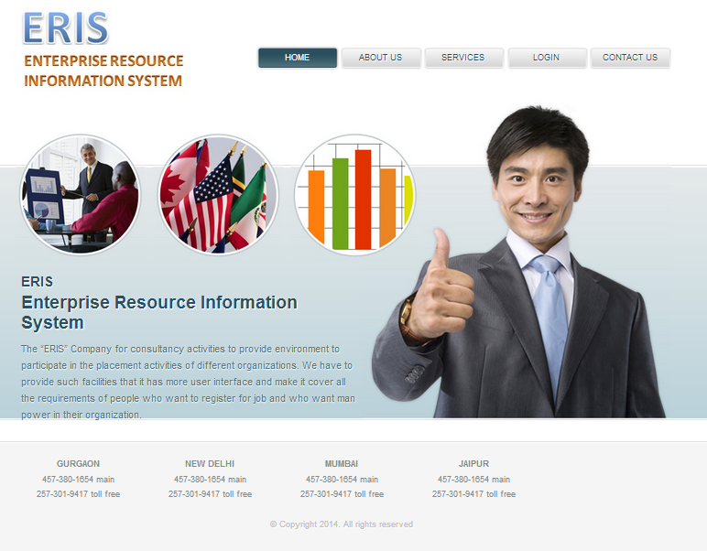

Slide 5
Objective of Proposed System
About ERIS is a web application built in JSP. It provides the applicants, ability to register to this application and search for jobs, manage their accounts. Each applicant will have an account with their own home page. On the other hand, Recruiters those are willing to publish the jobs for their company to applicants, can register to the ERIS and get their own account created and can post jobs to portal’s database. Registered Employers can add or remove jobs and these jobs can be seen by various applicants and they can apply for the job. Main aim of this web application is to make an user friendly platform where, applicant can search jobs easily and is accessible to everyone who are interested. The Purpose of the application is to provide Job portal for Job Seekers, to submit their CV and apply for job, where Recruiter can select best Employees from available candidate proﬁle.

Slide 6
Scope of the Proposed System
The scopes which are taken in our project are:
Registration ,Login and Logout.
Adding, viewing, updating applicant profile.
Searching and applying for job.
Viewing applicant interview list and result.
Adding new vacancy, interview results by recruiter.
Viewing all interview list and vacancy list by recruiter.
Viewing job applied to portal and vacancy.
Adding interview by administrator
Send mail, Viewing interview result and Client details by administrator.

Slide 7
Software Requirement
Operating System : Window XP,7,8
Front End : Netbeans 7.4.1
Client Side Scripting : Java Script
Web based Technologies : Java Server Pages, HTML ,CSS
Programming Language : Java
Database : My SQL
Server : GlassFish Server
Browser : Google Chrome(Testing)/Mozilla
Documentation Tool : Ms Office

Slide 8



The application comprises of major 3 modules :
1. Administrator
2. Applicant
3. Recruiter

Slide 9
Administrator
This module provides functions for the Administrator. It has following sub-modules:
Job applied-This is used to view the applicants who have applied to this consultancy and view their resumes.
Vacancy list-This is used to view the list of vacancies by different recruiters.
Add interview- This is used to add interview for applicants who have applied for the job.
Send mail-This is used to send notifications via mail to recruiter or applicant.
Interview result- This is used to view the interview result list of applicants.
Client Details-This is used to view the recruiters details.
Applicant-This is used to view the applicant details.
Logout This is used to log out from the account.

Slide 10
Applicant
This module provides functions for the Applicant. It has following sub-modules
Add profile-This is used to enter the applicant details.
Update profile-This is used to update the details entered by applicant.
View profile-This is used to view profile in resume format.
Jobs-This is used to search and apply for jobs.
Interview –This is used to view applicants interview list.
Results-This is used to view results of applicant interview.
Logout -This is used to log out from the account.

Slide 11
Recruiter
This module provides functions for the Recruiter. It has following sub-modules:
Add vacancy-This is used to add new vacancies for applicants.
Add Result-This is used to add the result of the interview.
Interview list-This is to view the interview list.
Vacancy list-This is used to view the vacancy list.
Logout- This is used to log out from the account.

Slide 12
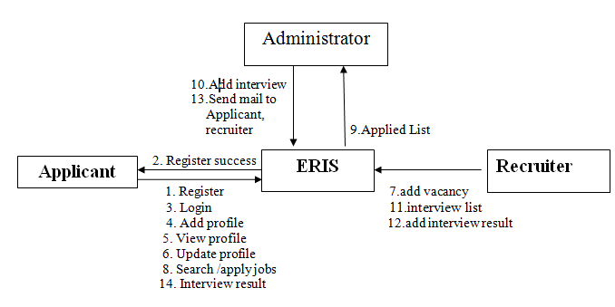
Module Collaboration Diagram

Slide 13
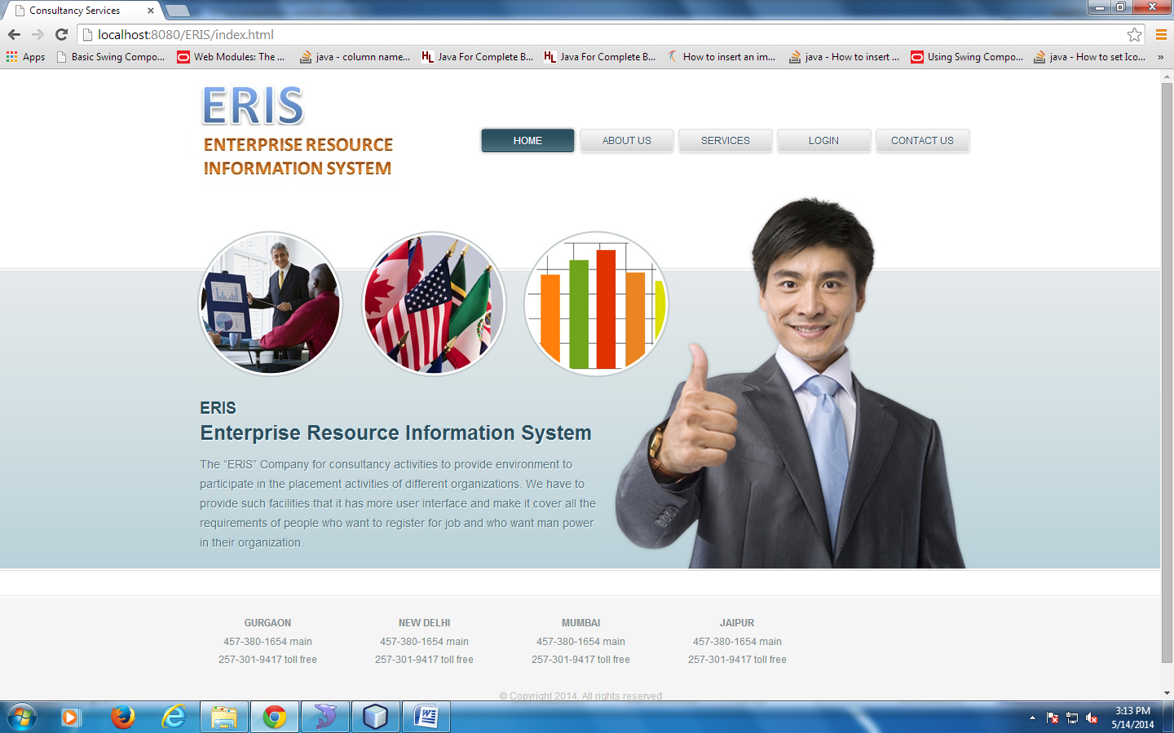
User Interface Design Input Screen Design Preview

Slide 14
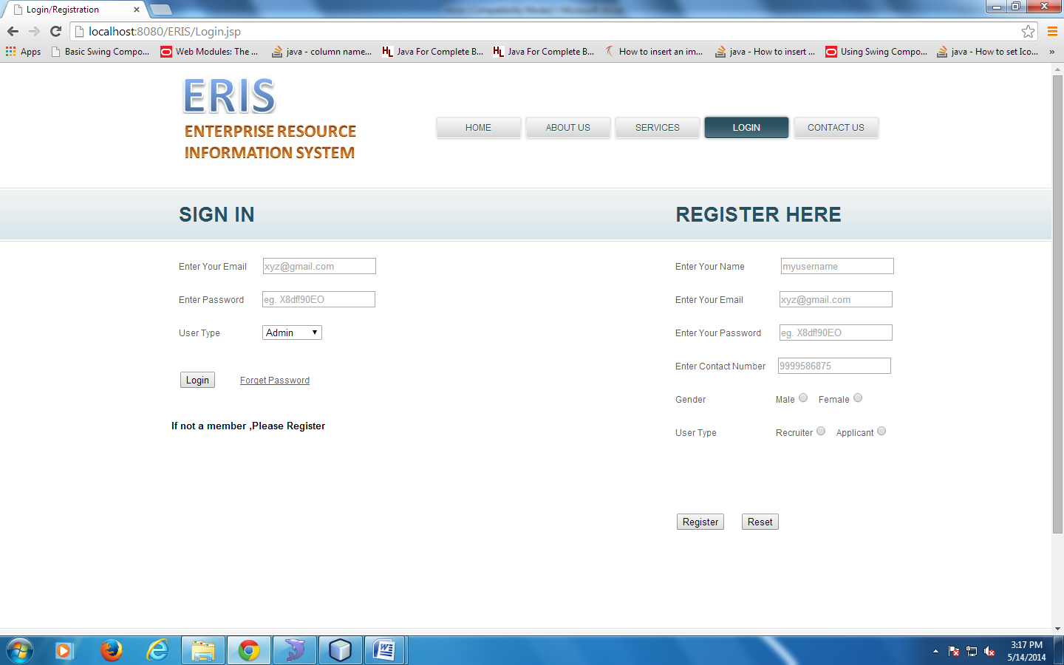
LOGIN PAGE

Slide 15
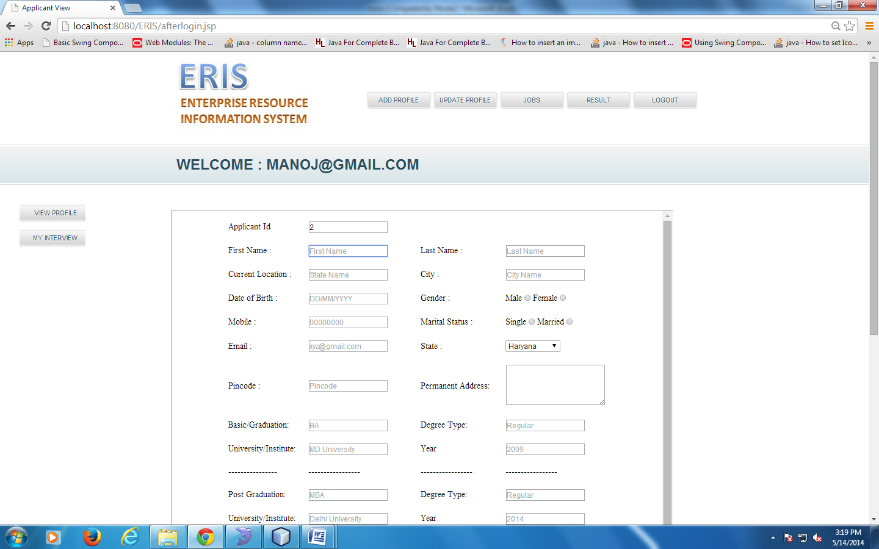
ADD PROFILE PAGE

Slide 16
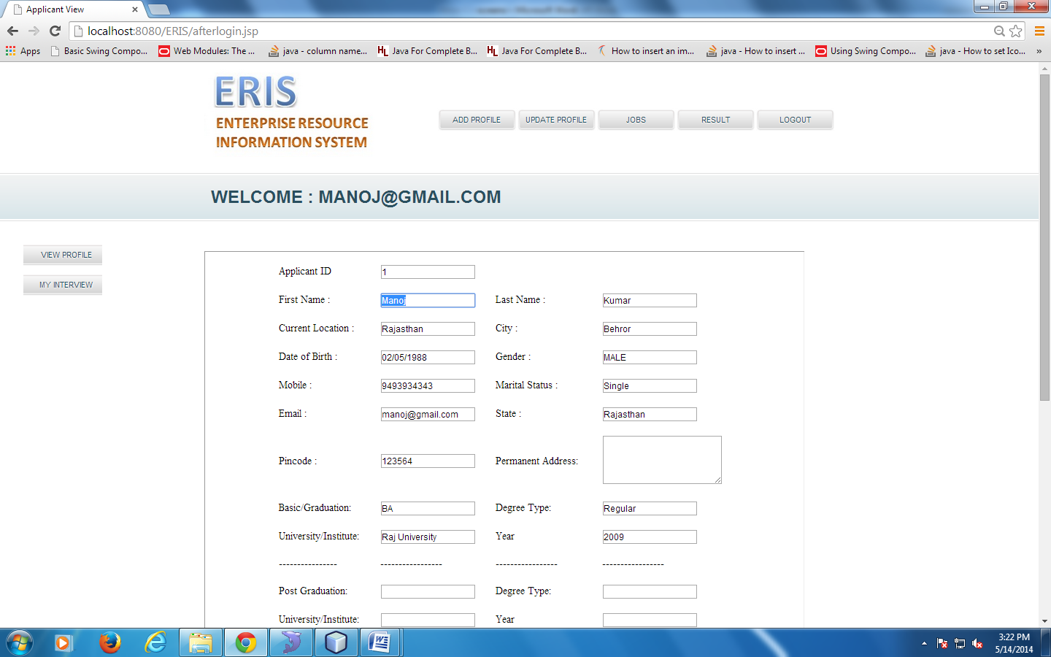
UPDATE PROFILE PAGE

Slide 17
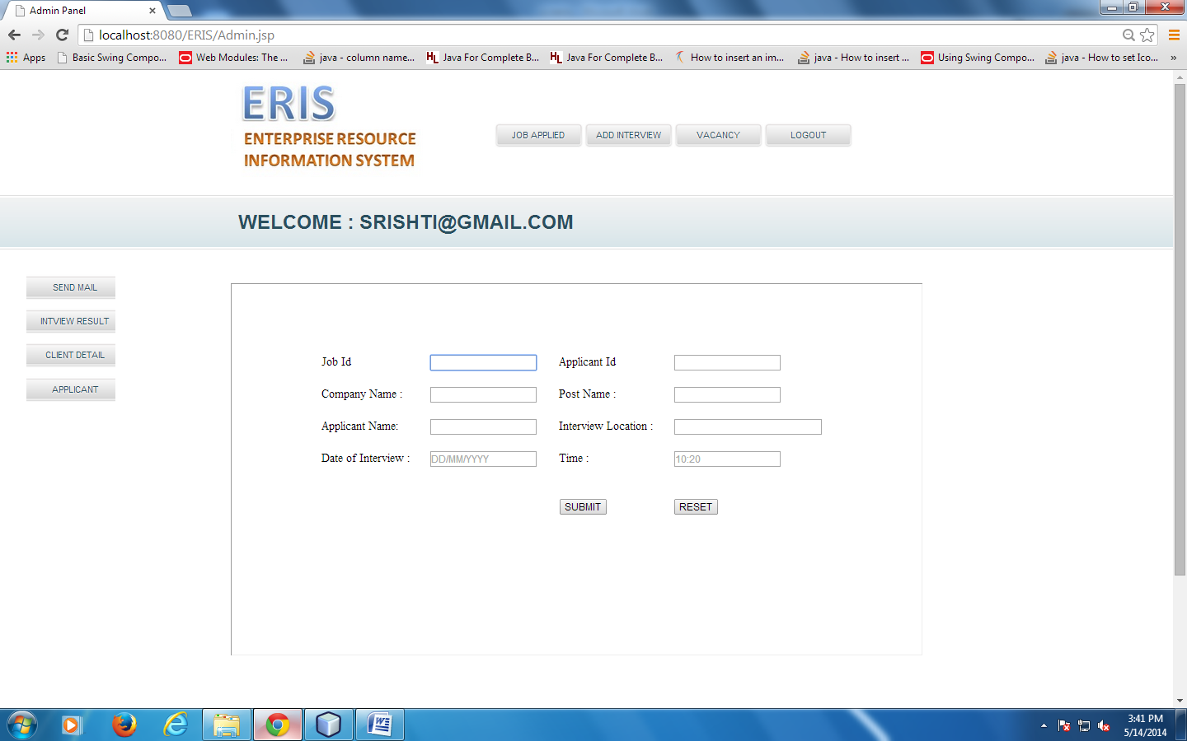
ADD INTERVIEW

Slide 18
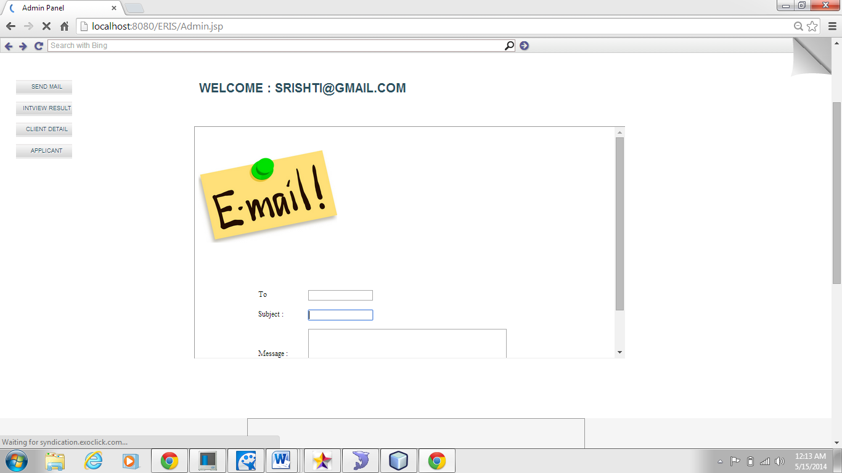
SEND EMAIL PAGE

Slide 19
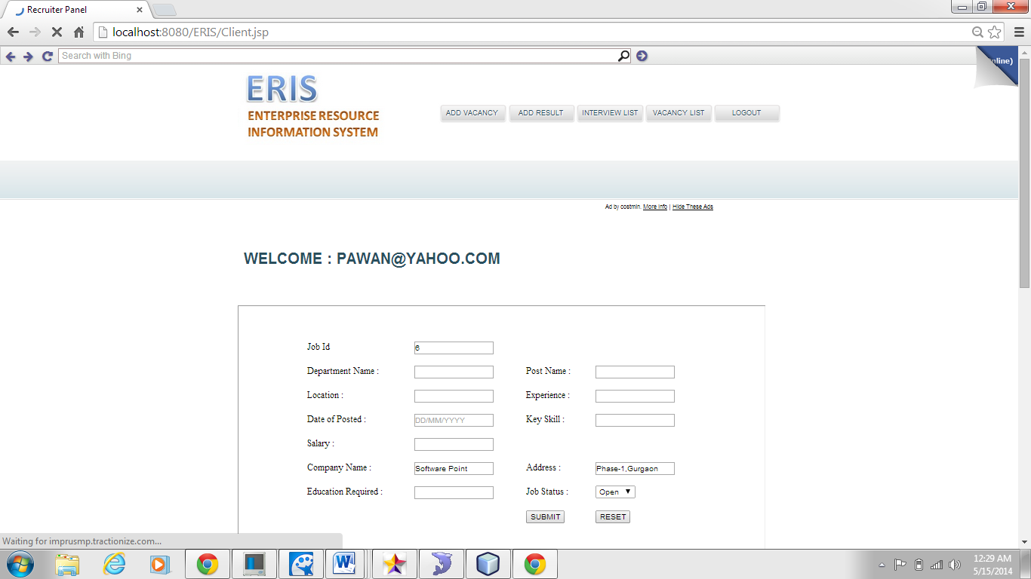
ADD VACANCY PAGE

Slide 20
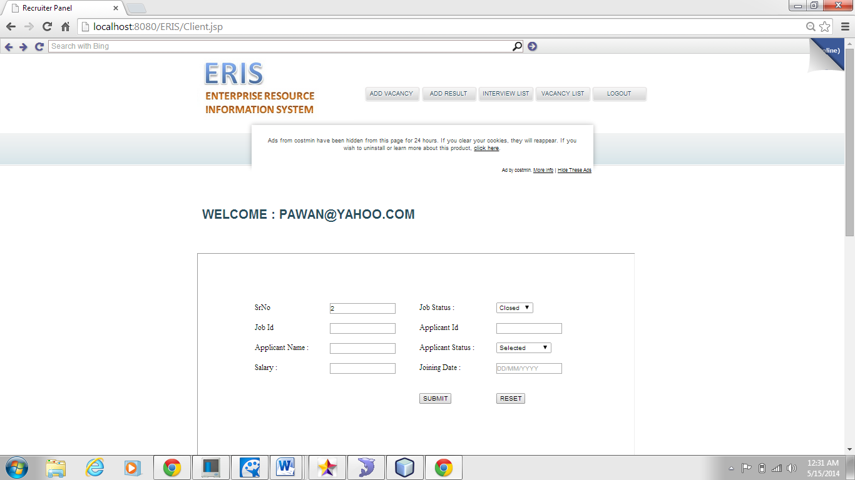
ADD RESULT PAGE

Slide 21
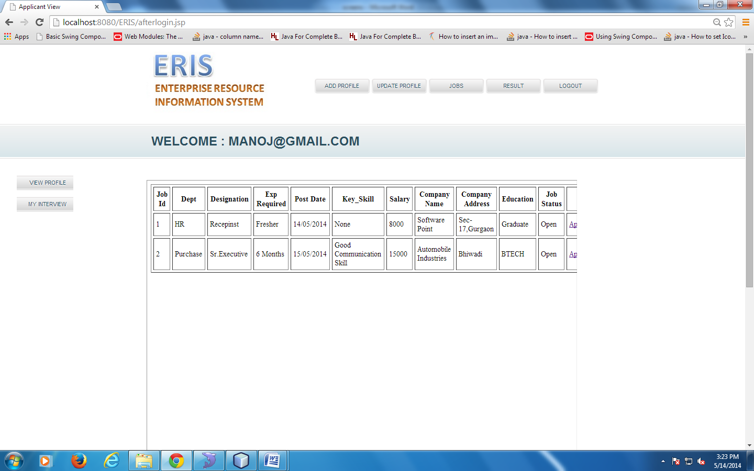
Reports/Outputs Design Preview
JOBS PAGE

Slide 22
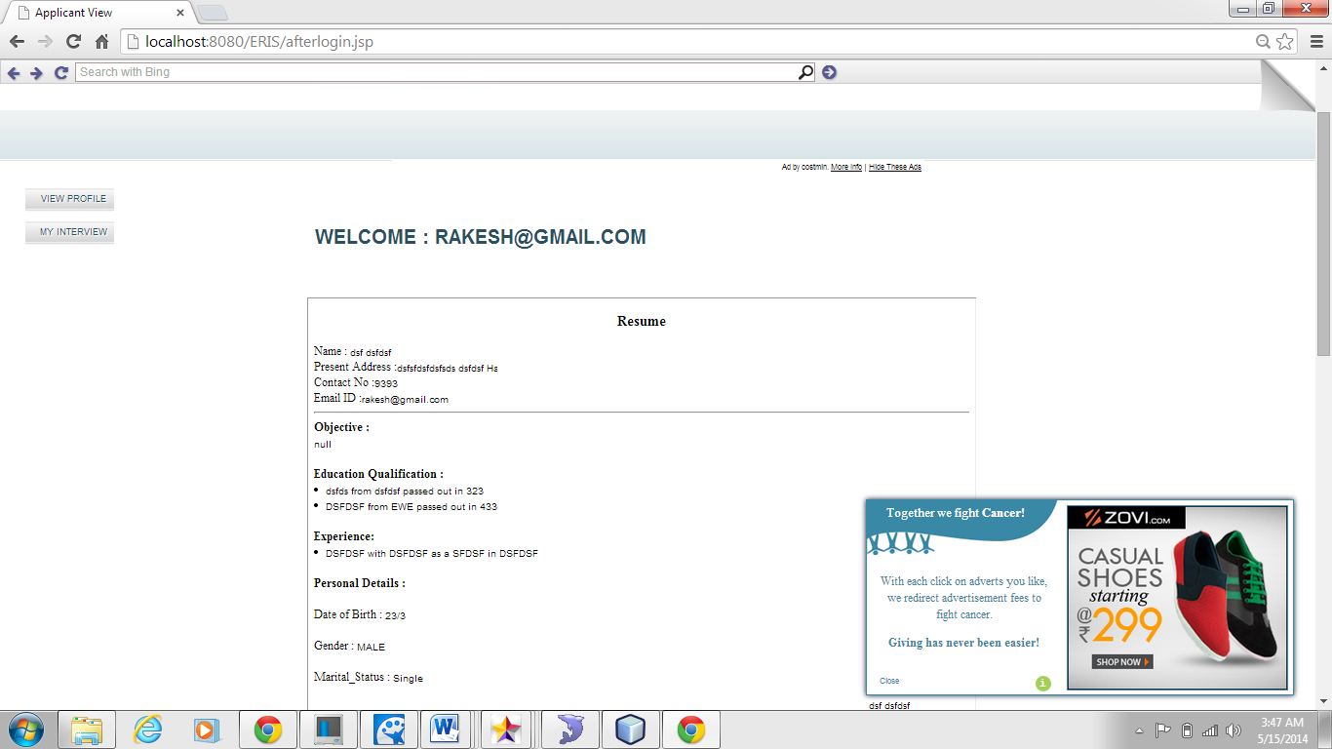
VIEW PROFILE PAGE

Slide 23
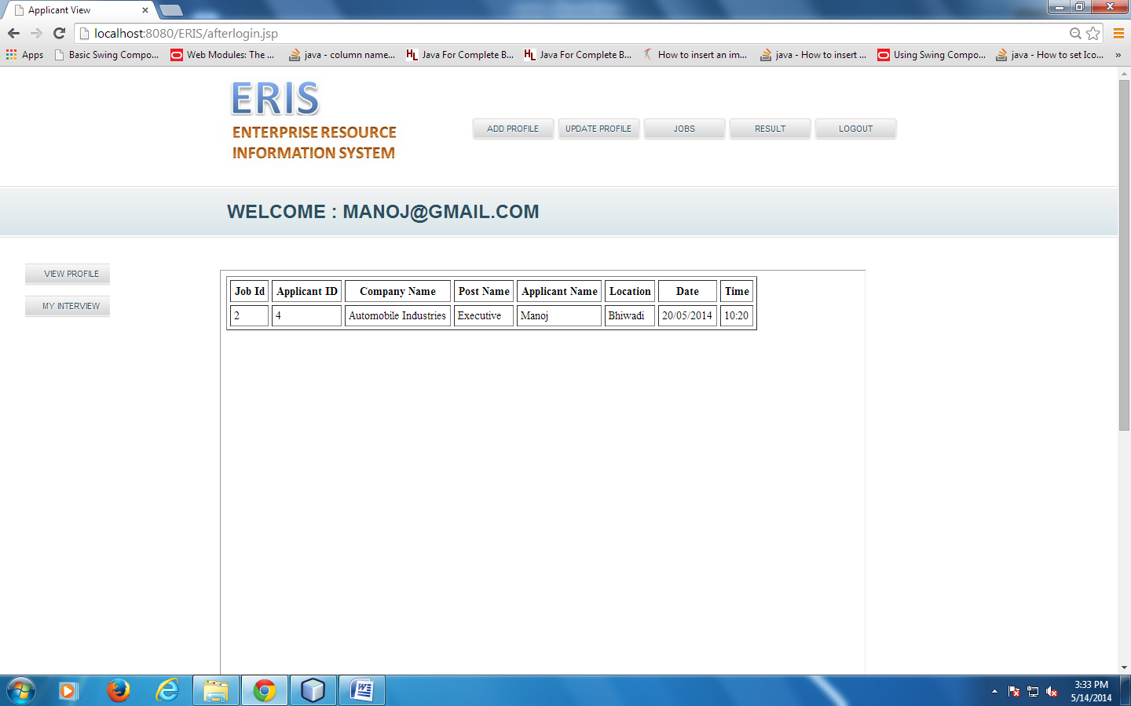
MY INTERVIEW PAGE

Slide 24
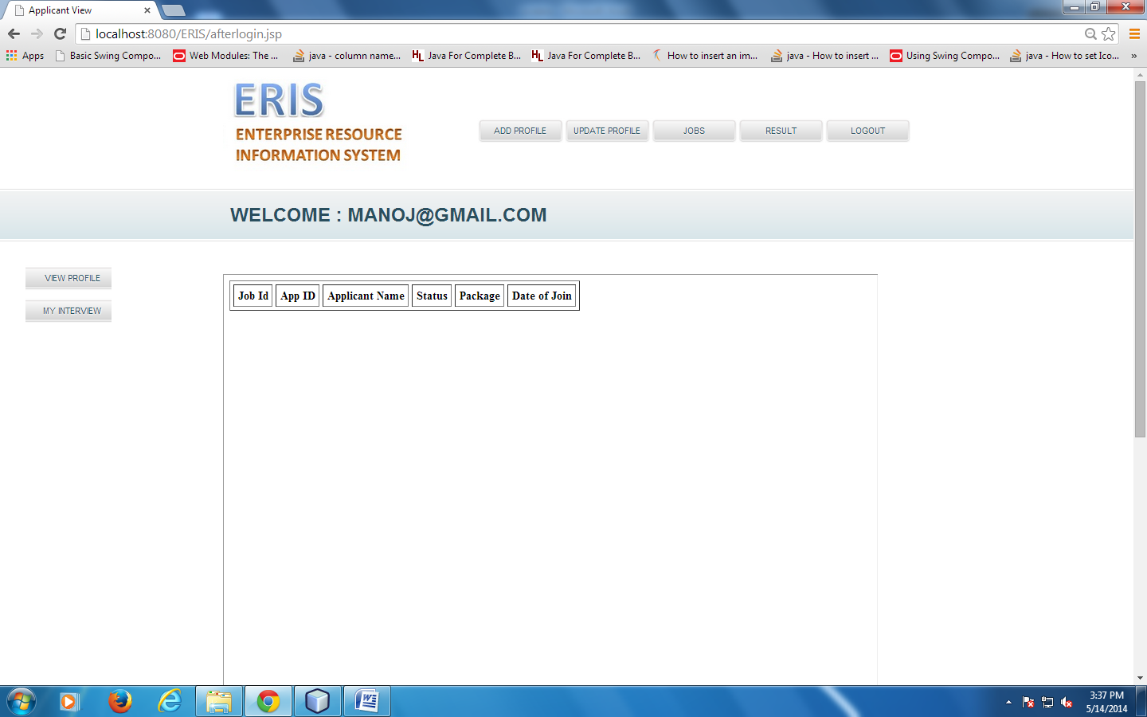
RESULT PAGE

Slide 25
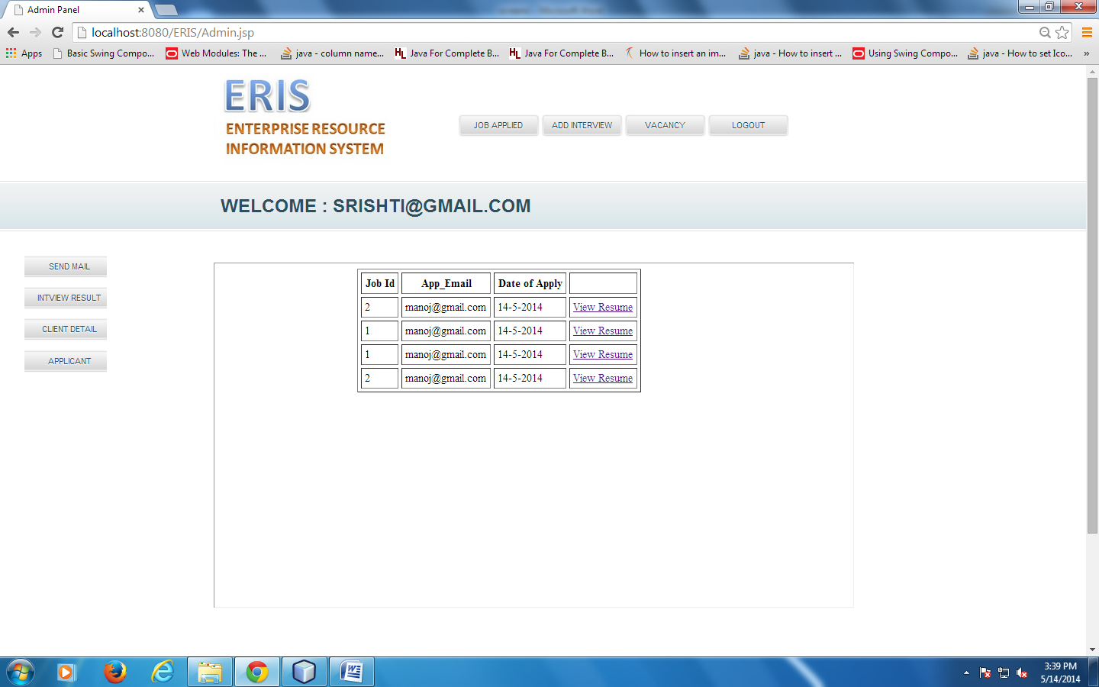
APPLICANT PAGE

Slide 26
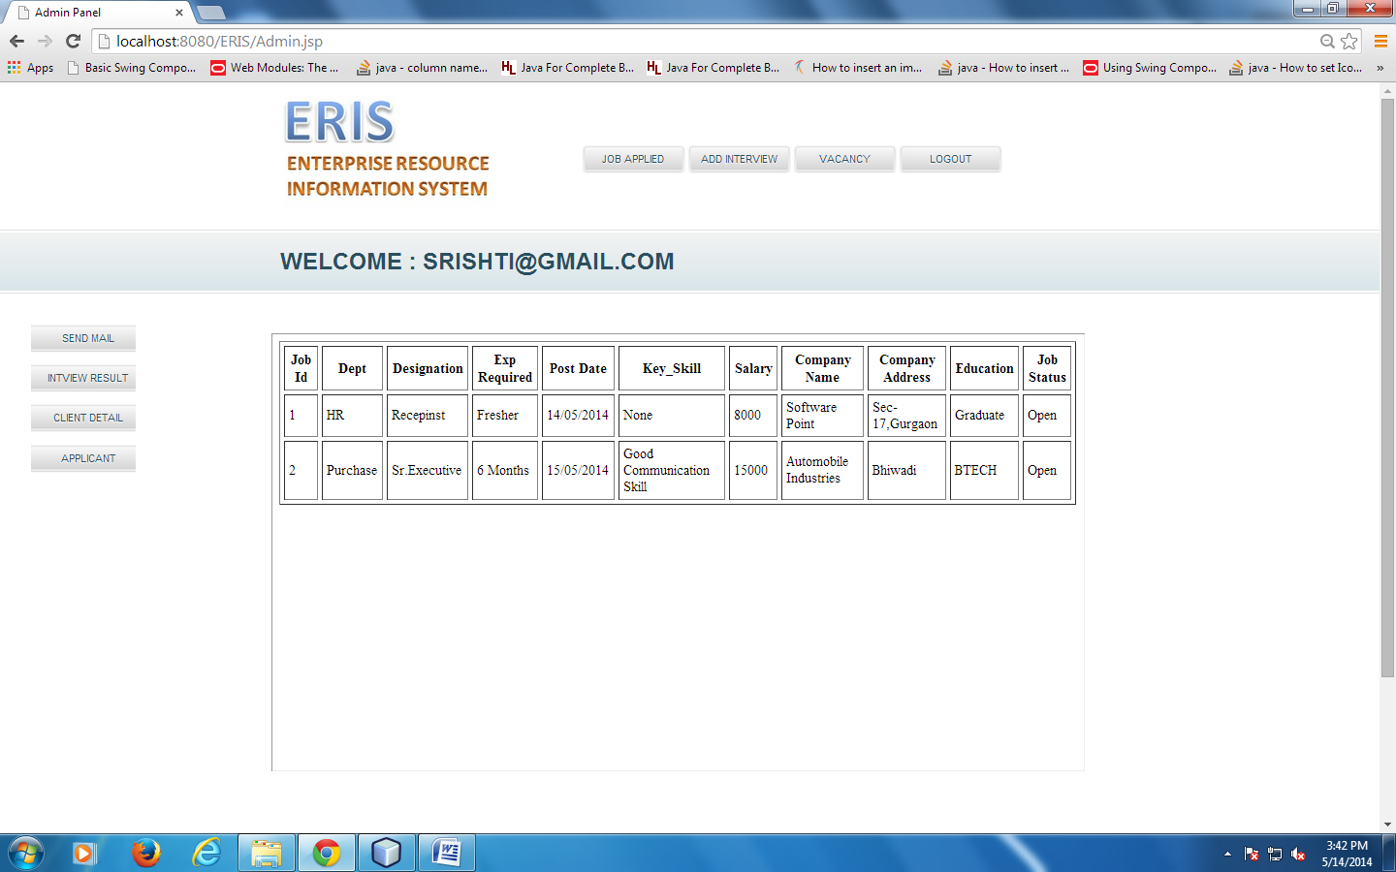
VACANCY PAGE

Slide 27
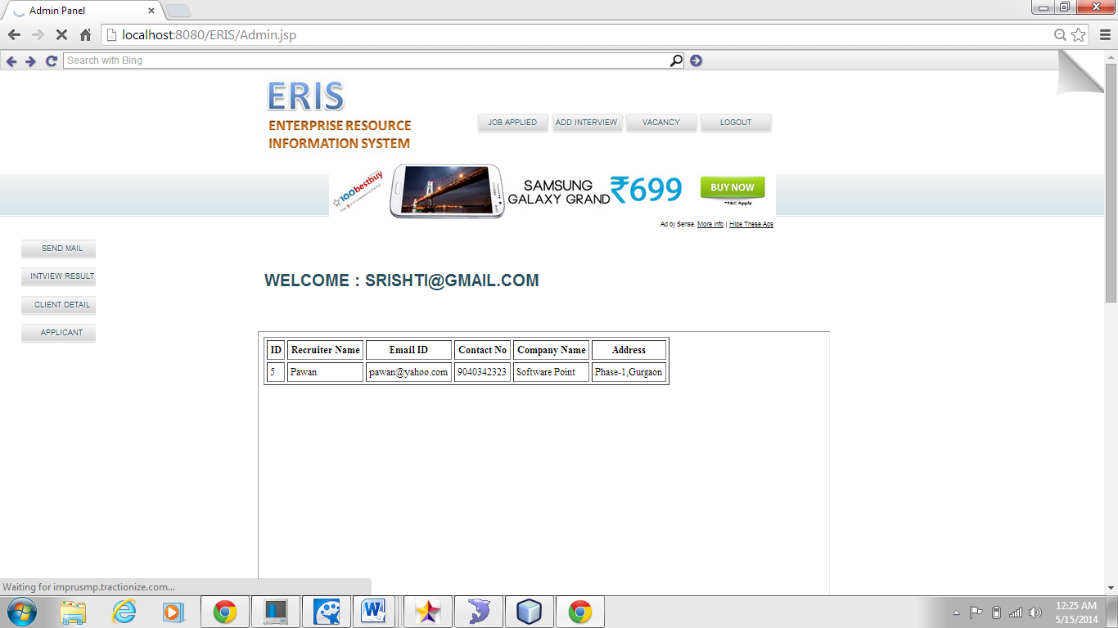
CLIENT DETAIL PAGE

Slide 28
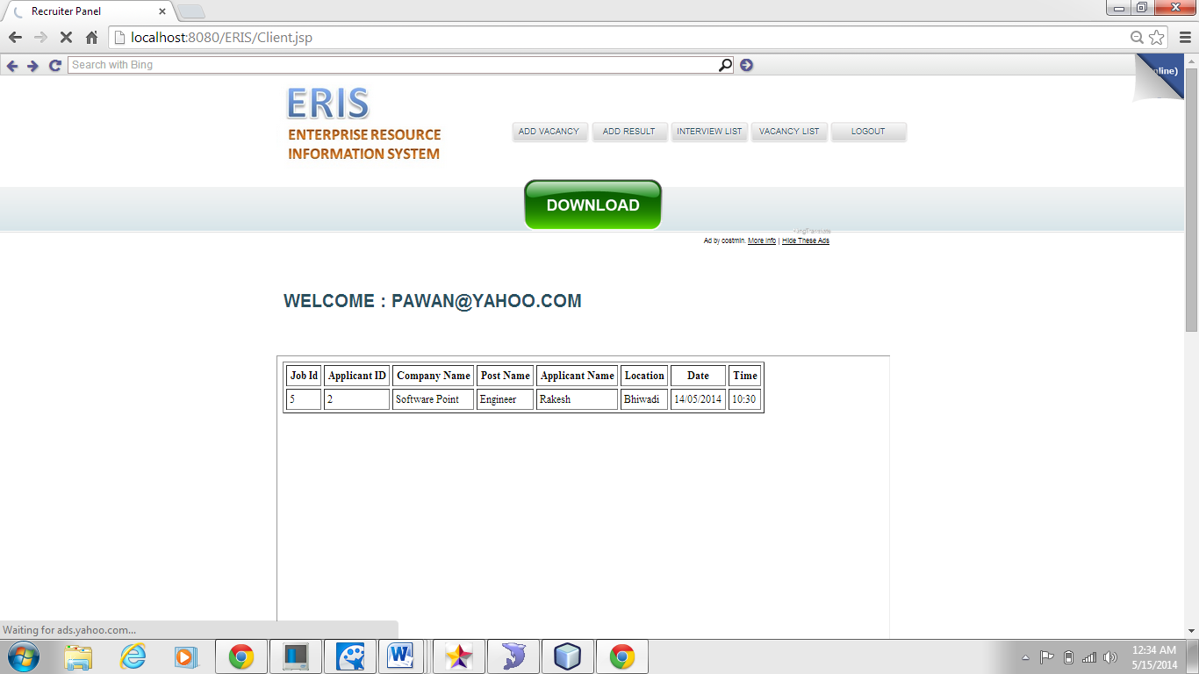
INTERVIEW LIST PAGE

Slide 29
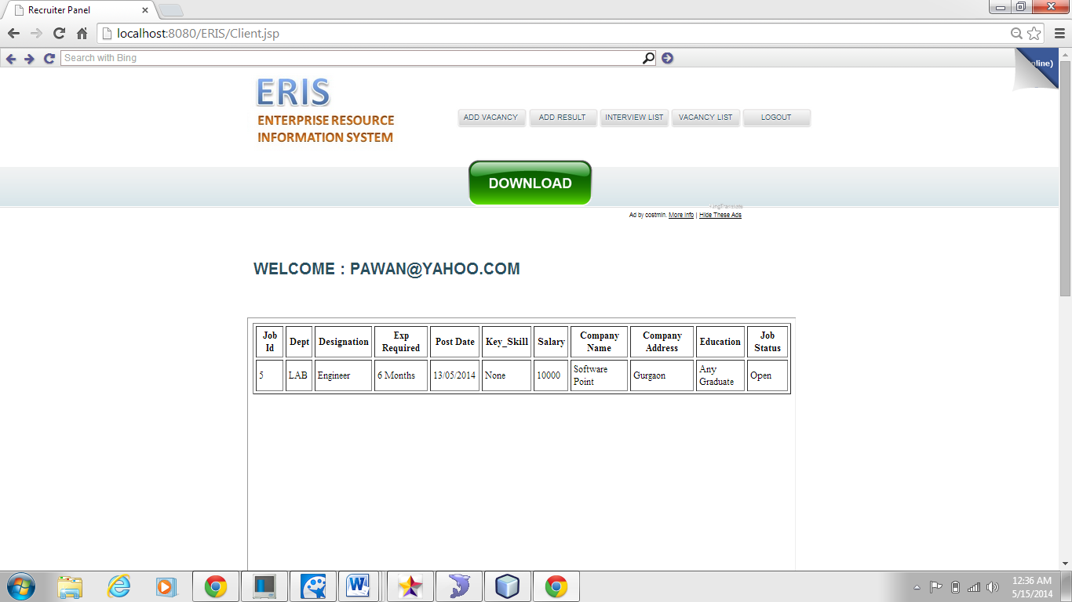
VACANCY LIST PAGE

Slide 30
About Scholar
Scholar Details
Name: Srishti Sukhralia
Roll No: 2K10-MRCE-CSE-113
Course: B.Tech (Computer Science & Engineering)
Year: 4th Year
Project Details
Project Title: Enterprise Resource Information System
Nature of Project: Software Development
Name of Organization: Tech Mahindra limited, Noida
Industry Type: Information Technology

